Slide 1
Yr 12 Re-cap Starter Test Materials and their Working Properties

Slide 2
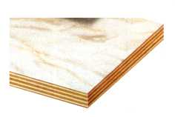

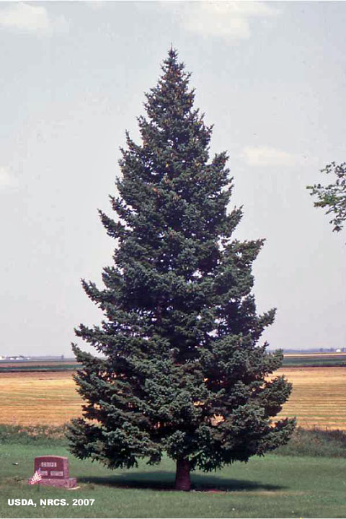
Wood what are the working properties of these different types
of wood? Annotate each picture.

Slide 3
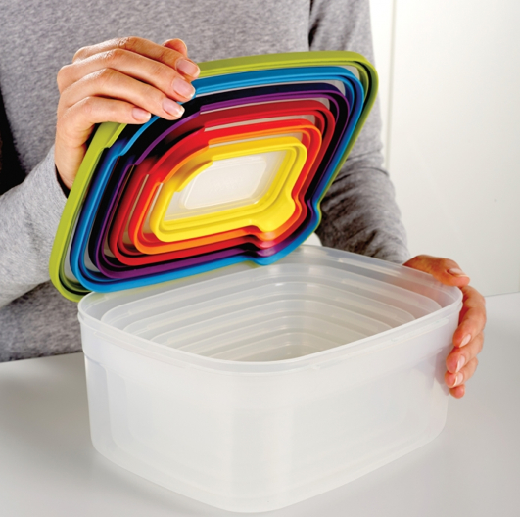
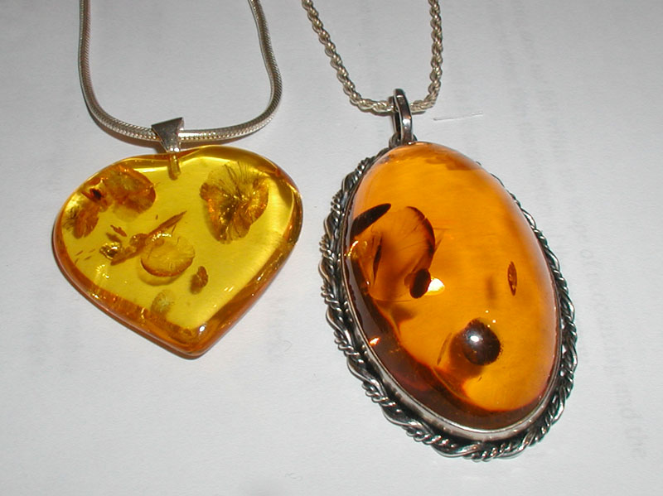
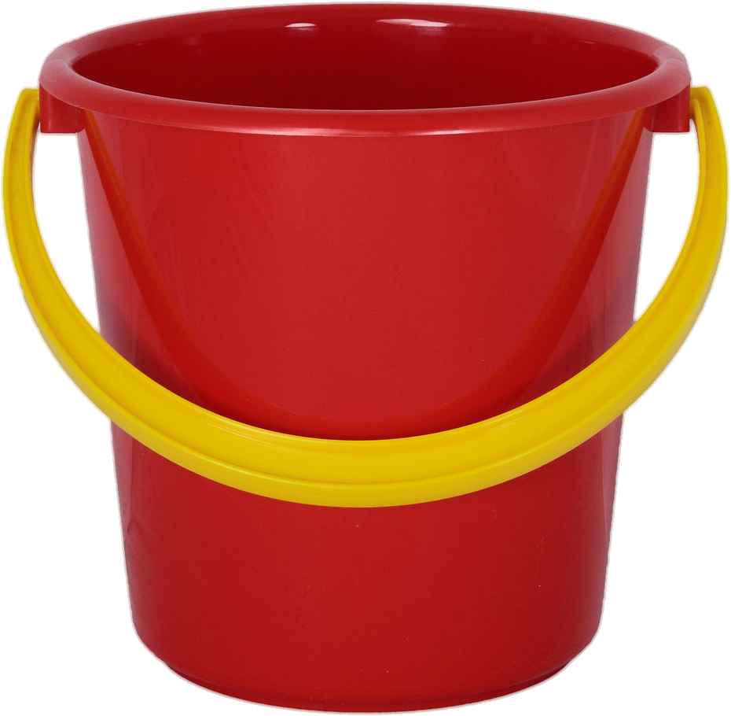
Plastics what are the working properties of these different types of plastics? Annotate each picture.

Slide 4
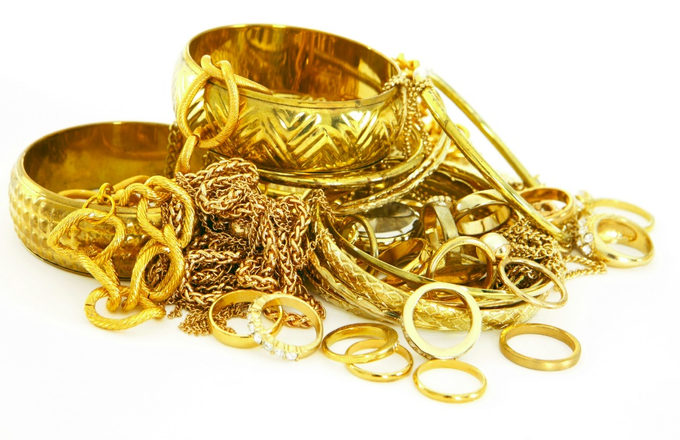
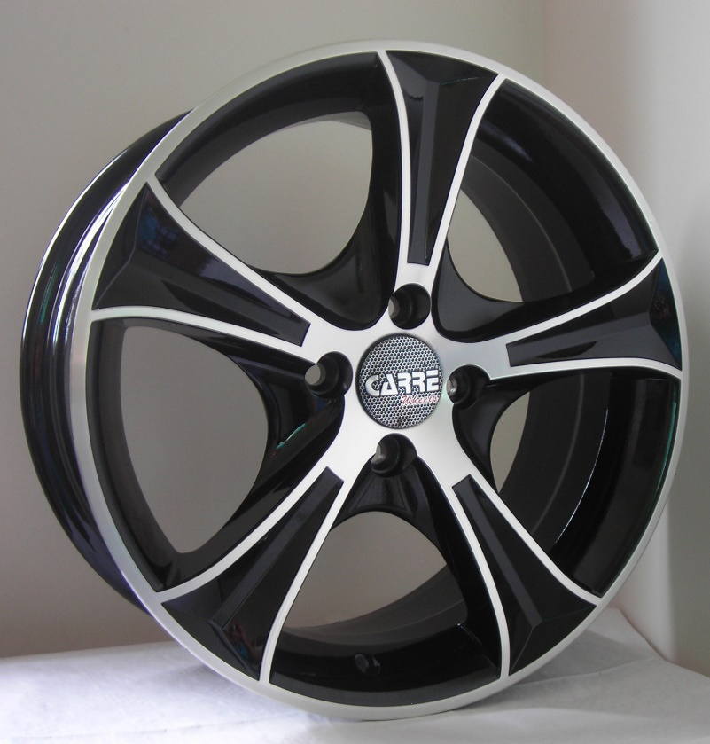
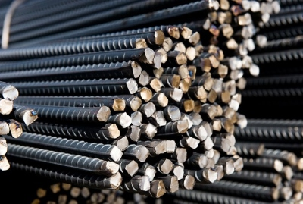
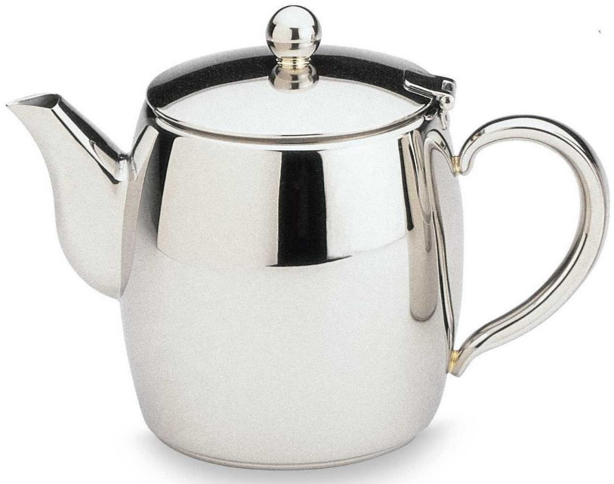
Metals what are the working properties of these different types
of metals? Annotate each picture.

Slide 5
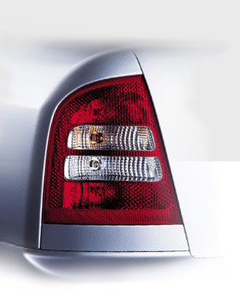
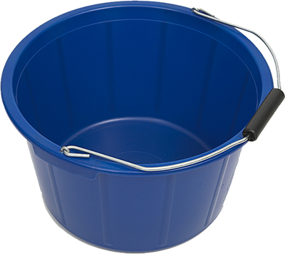
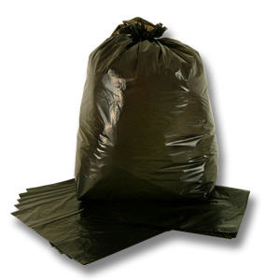
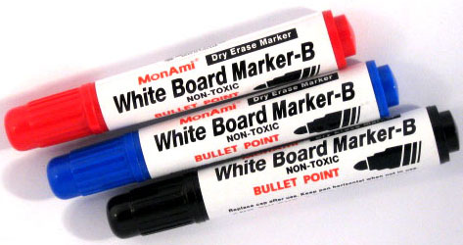
Plastic what plastics could be used in these products and why?
Polythene
Acrylic
Polythene
Polystyrene

Slide 6
Plastic what plastics could be used in these products?
Polythene (high density)- tough
Polythene (low density)-
Soft and flexible
Acrylic- see through
Polystyrene- cheap, hard and colourful

Slide 7
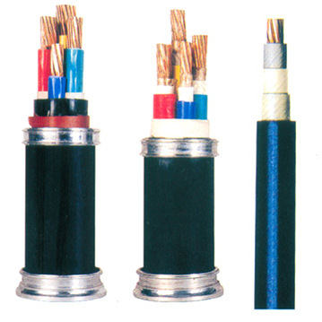
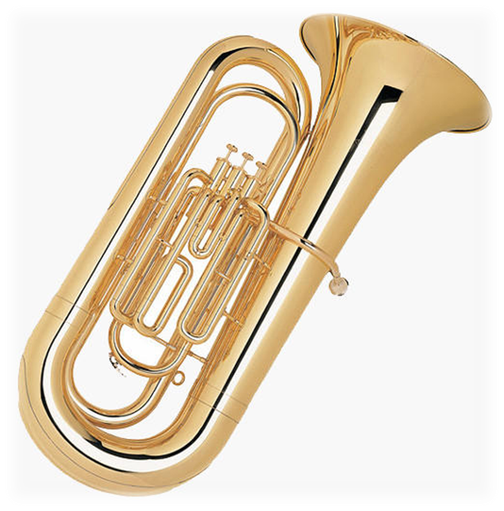
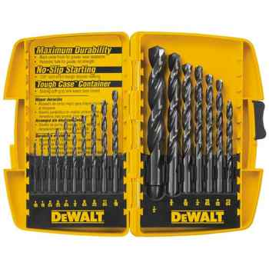
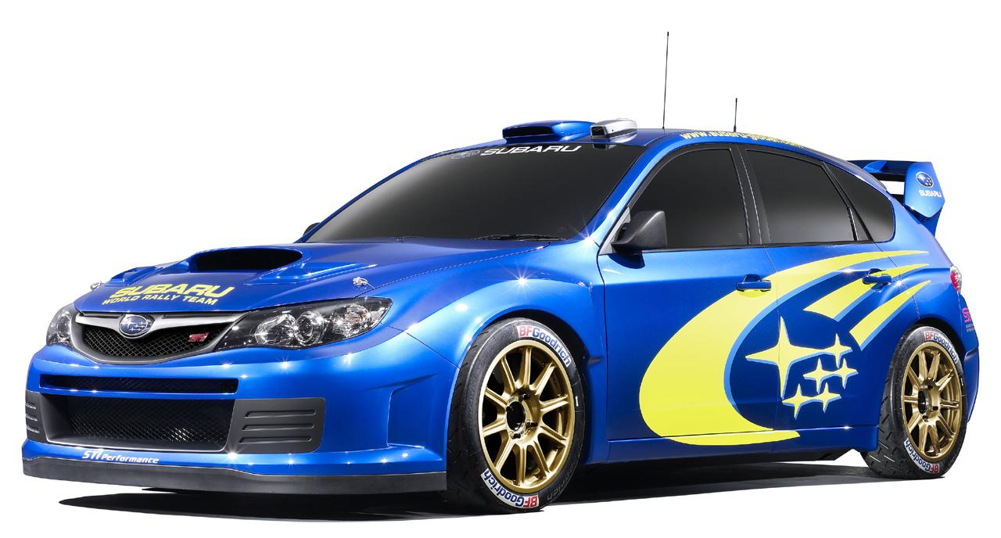
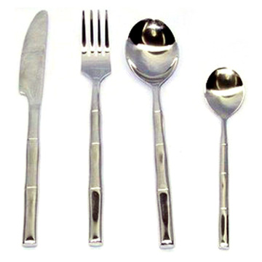
Metal what metals have been used for these products? Why?
Brass
Stainless steel
Mild steel
copper
Carbon steel

Slide 8
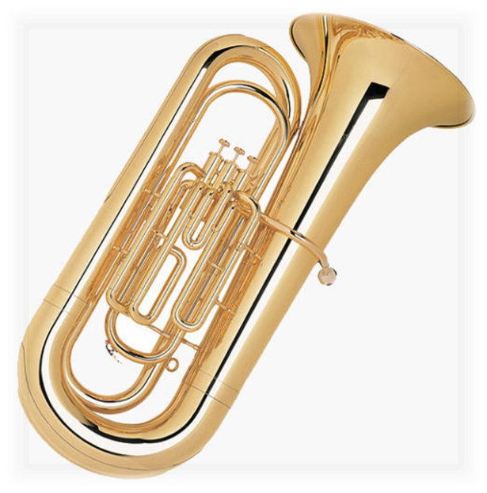

Metal what metals have been used for these products? Why?
copper
Brass
Carbon steel
Mild steel
Stainless steel

Slide 9

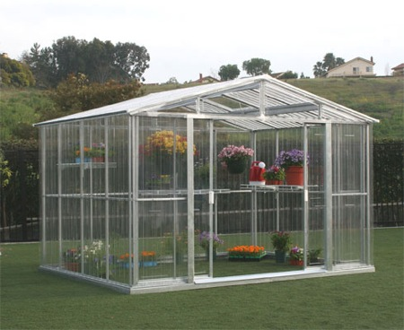

Think about the Manufacturing Processes used to make these Products
Which is the odd one out?
Why is the green house the odd one out?
Why is the bean can the odd one out?

Slide 10
Why is the green house the odd one out?
It is extruded not deep drawn
Why is the bean can the odd one out?
It is mild steel coated with tin.
The others are aluminium
Notes:
10

Slide 11
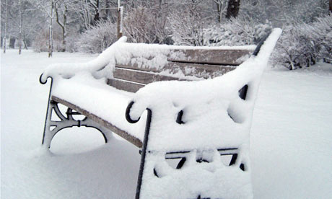
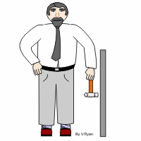
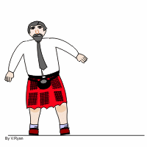
Properties of Materials
Tough Hard Durable
Will withstand
blows
Will resist
Abrasive wear
Will resist wear and tear and weathering
Which of these properties apply to the products on the next slide?

Slide 12
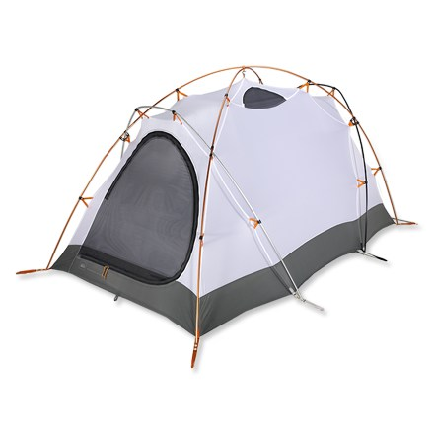

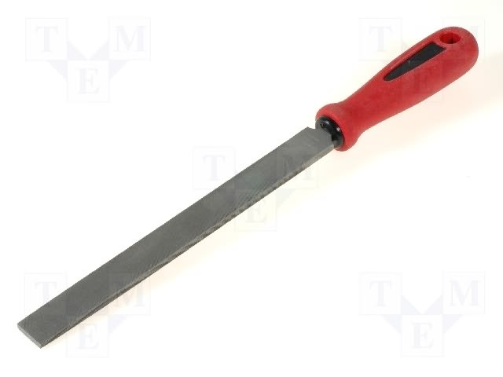
What properties do these products have?
why?

Slide 13
Durable
It lasts well in bad weather
Tough
(you can kick it and it wont break)
Hard-It shapes metal by scratching it

Slide 14
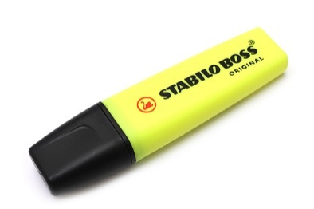
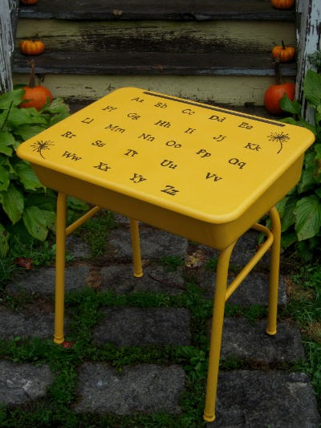
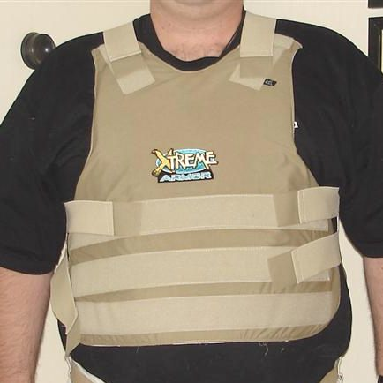
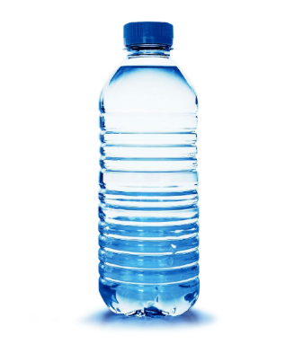
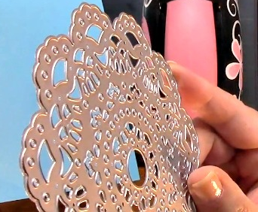
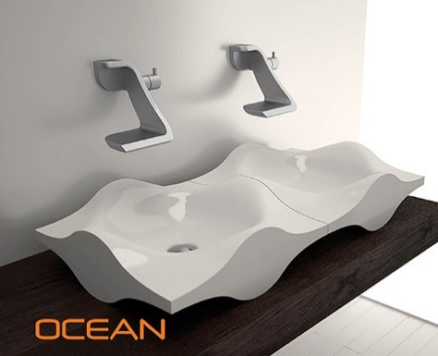
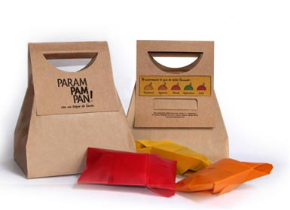
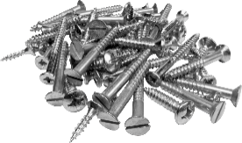
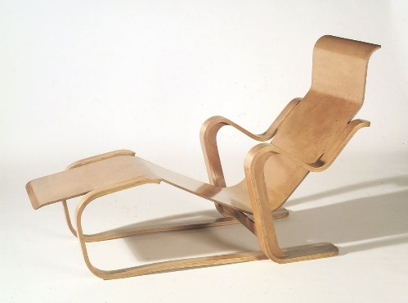
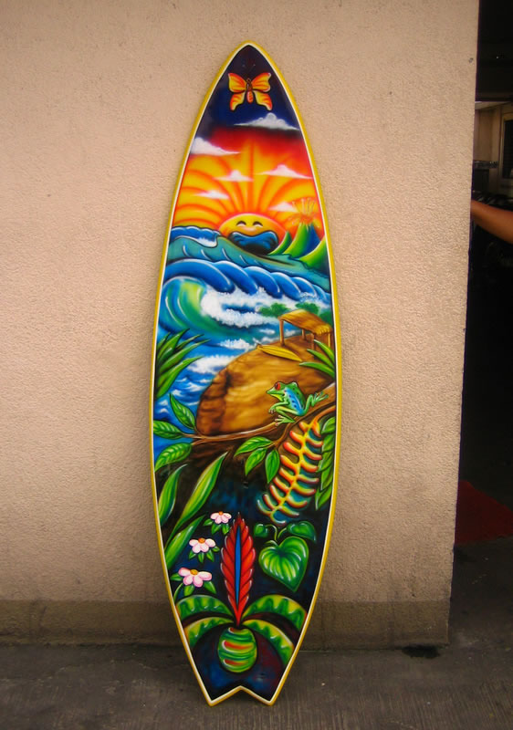
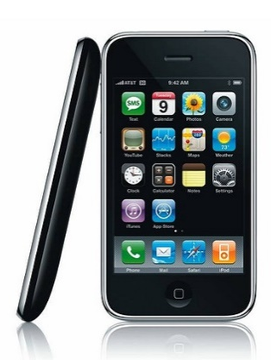
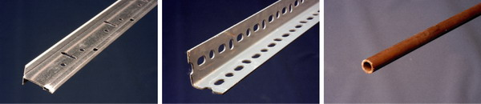
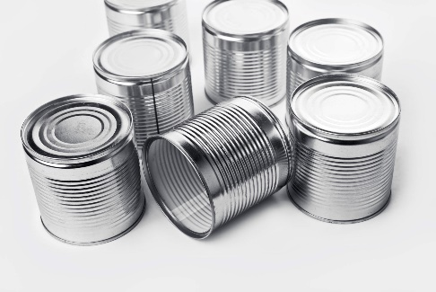
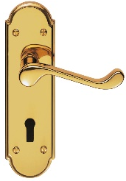
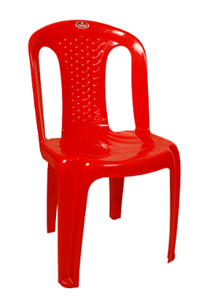
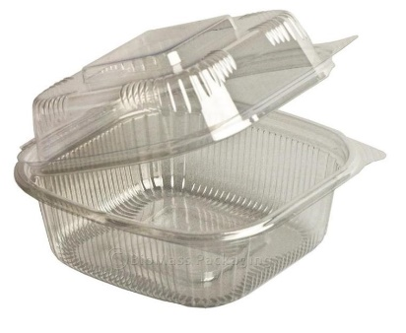
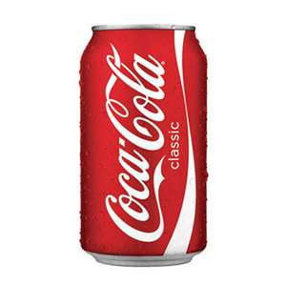
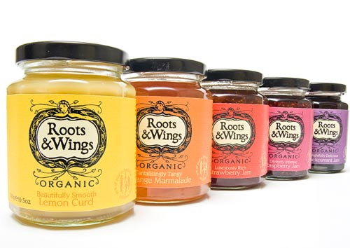

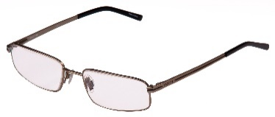
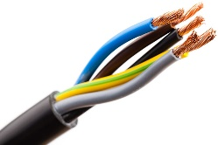
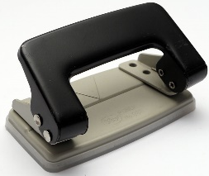
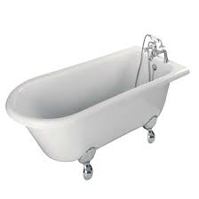
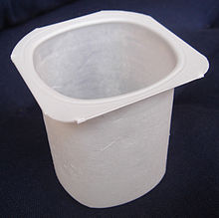
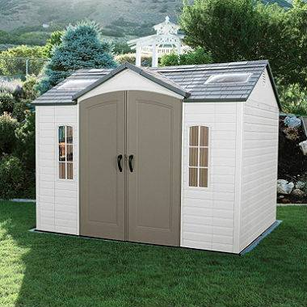
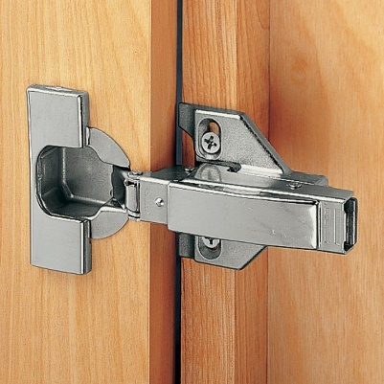

TASK Challenge: Try to name as many of these products as you can and complete the details for each one in the table on the next slides.
3
4
5
1
8
7
6
2
13
9
10
11
12
14
19
17
18
15
20
16
24
25
22
23
21
26
27

Slide 15
No | Name of Product | Material made from | Material Properties | Manufacturing processes used

Slide 16
No | Name of Product | Material made from | Material Properties | Manufacturing processes used

Slide 17
No | Name of Product | Material made from | Material Properties | Manufacturing processes used

Slide 18
No | Name of Product | Material made from | Material Properties | Manufacturing processes used

Slide 19
No | Name of Product | Material made from | Material Properties | Manufacturing processes used

