Slide 1
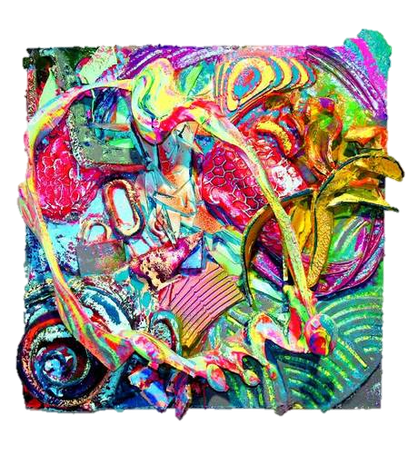
Year 11 into 12 Art Summer bridging work SURFACES
The summer project is very important. It is not optional.
This is the starting point for your A Level coursework portfolio.
This summer project shows your teachers how you work independently, which is especially useful if you are joining JCoSS from another school.
If you are away over summer, you must still do the project, but you may have to be more creative about your use of materials and techniques.
You can visit galleries abroad as well as in London.
Do not leave it until the last minute – read through the whole Powerpoint first, then get started right away.
It should be fun, creative and enjoyable!

Slide 2
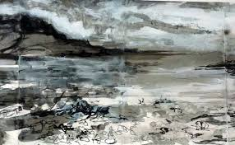
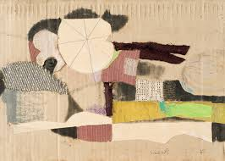
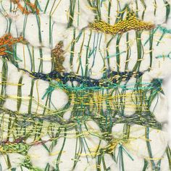
Step 1: Foundations
Focus: Making & exploring surfaces
Task: Make a sketchbook using found papers – e.g., envelopes, newspapers, brown paper, old maps, packaging, receipts, wallpaper samples, book pages, etc.
Binding Options: Japanese stab binding, simple stitch, or bulldog clips.
Introductory Drawing: Use graphite, charcoal, pen, and ink to draw directly onto these surfaces. Focus on texture and materiality.
Photography: Begin collecting photographs of urban/textured surfaces (brick, glass, rust, peeling paint, moss, pavements, graffiti, posters, rain on windows).
Annotation Prompt: How do different surfaces affect your process of mark-making and meaning?

Slide 3
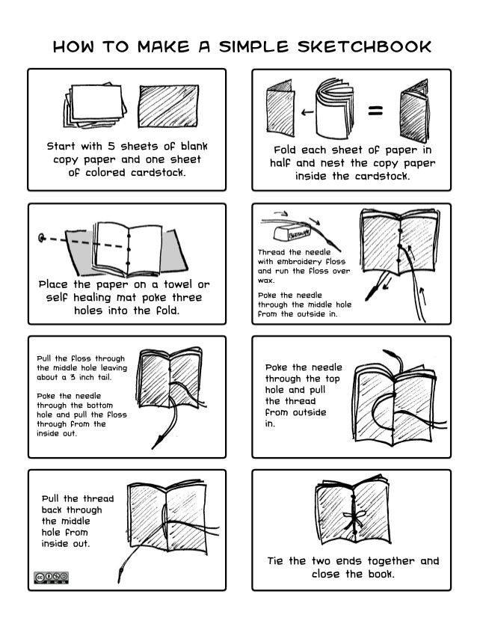
Tips and suggestions:
You could use….
Plain cartridge paper
Lined paper
Coloured paper
Squared paper
Graph paper
Dotted paper
Old envelopes
Wrapping paper
Bubble wrap
Corrugated card
Tissue paper
Tracing paper
Metallic paper
Newspaper
Magazine pages
Old sketchbook pages
Punched pockets
How to make a simple sketchbook — HELEN WELLS ARTIST
https://thewildcherryfarm.com/diy-sketchbook-tutorial/

Slide 4
TEXTURED SURFACES
Soft or textured surfaces
Flesh
Brickwork
Silk
Cobbles
Feathers
Roofs
Moss/Fungi
Fabric
Hair
REFLECTIVE SURFACES:
These can show what is BEYOND the surface…
Glass – Concave, convex
Mirrors
Broken
Vehicle Bumpers
Chrome Kitchen Implements
Glass Baubles
Reflect and Distort
Ponds, lakes, Rivers, Puddles.
BENEATH THE SURFACE
Fish/ Weeds
Rivers/Lakes
Jungles
Burrows – Reptiles & Insects
Beneath the surface of the mind
Subconscious/Conscious
ABOVE THE SURFACE
Aerial views
Maps
Journeys
Exteriors/wrappings
It might be easier to narrow down your theme:
Here are some starting points to get you thinking…
DECAYING SURFACES
Decay in modern city
Empty buildings
Street Rubbish
Torn Posters
Abandoned buildings
Burnt Buildings
Scrap yards
Rusted Metal
Decomposed Food
BROKEN SURFACES – these may reveal what is BENEATH the surface
Torn
Tattered
Ripped
Folded
Crushed
Pleated
Cut or Burnt
Cracked Paint revealing colour
PATTERNED SURFACES
Random
Regular
Geometrical
Optical Illusions
Relief
Natural
Glazed
Surface Decoration
Mosaic

Slide 5
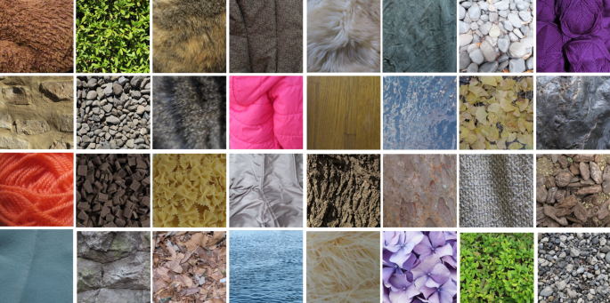
Photography

Slide 6
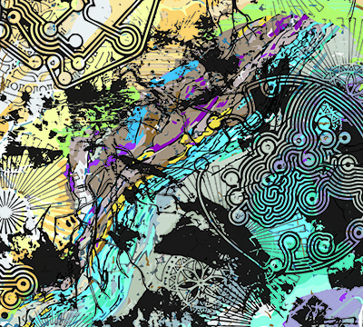
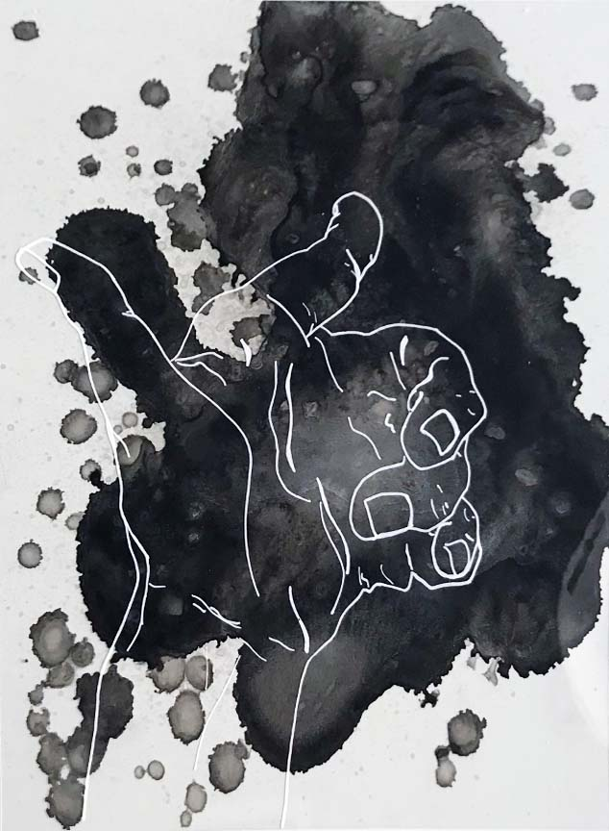
Step 2: Experimentation
Focus: Media exploration
Task: Create experimental surfaces:
Collage with torn layers
Use bleach, wax, ink, tape, latex, gesso, or glue to distort and react with surfaces
Try frottage, mono printing, and tracing texture.
Photography: Focus on reflections, worn textures, decay.
Drawing Prompt: Draw surfaces using non-traditional tools (sticks, sponges, credit cards, string).

Slide 7
PROMPTS FOR EXPERIMENTATION Draw
Print
Tear
Stick
Cut out
Shred
Reassemble
Reorder
Sculpt
Scratch
Play
Model
Compose
Change
Stretch
Overlap
Overlay
See through
Cut away
Resize
Rub away
Scratch through
Scrape
Turn over
Turn around
Layer
Destroy
Reinvent
Roll up
Tie
Thread
Stitch
Decorate
Take away
Add to
Fold
Pleat
Burn
Dye
Make rubbings
Emboss
Etch
Carve into
Peel
Paint over
Extend
Reduce
Stipple
Zoom in
Zoom out
Interweave
Photograph
Edit
Recolour
Invert
Draw over
Paint over
Rephotograph
Bleach
Wash away
Tape over
Staple

Slide 8
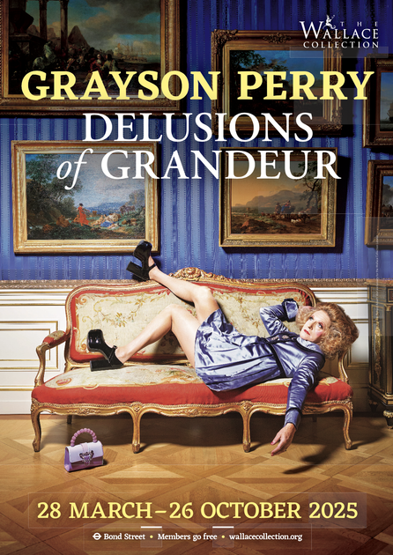
Step 3: Artist response
Visit: Two different galleries with relevant work
For one of these we recommend the Grayson Perry exhibition at the Wallace Collection – this fits well with the theme.
Task: Choose one artist and produce:
A visual response (in their style, using your surfaces)
Annotation/analysis in sketchbook
Try working on a surface the artist might use or referencing their process
Critical Thinking: How does the artist use surface as meaning, not just texture?

Slide 9
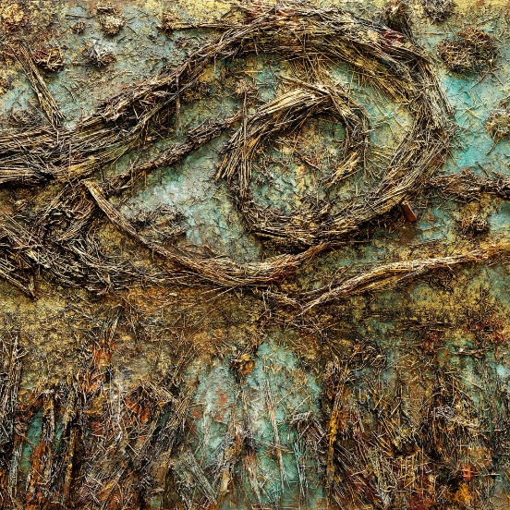
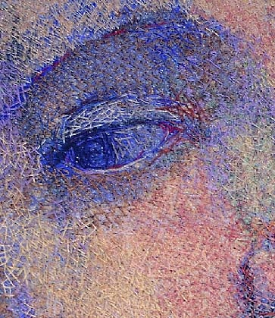
Other suggested London galleries
Tate Modern (e.g., Anselm Kiefer, El Anatsui, Mark Bradford)
Whitechapel Gallery
Barbican
Victoria Miro Gallery
Serpentine (for contemporary installations)
V&A for objects and artefacts
British Museum for objects and artefacts
Anselm Kieffer
Audrey Walker Stitched portrait

Slide 10
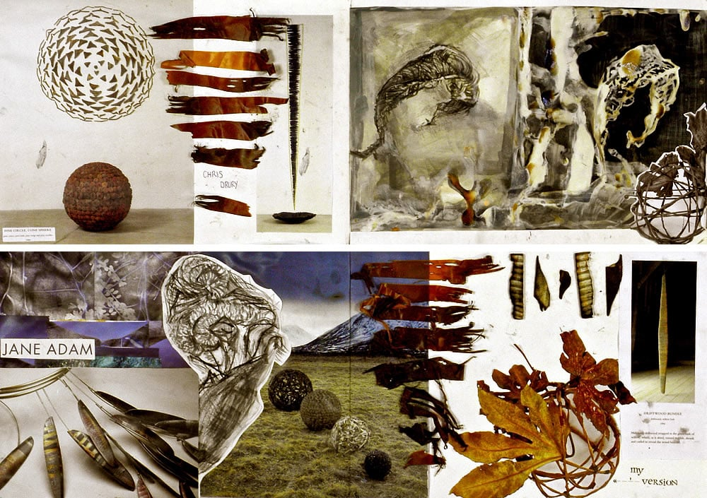
Task 4: Developing ideas
Focus: Concept development
Task: Take your strongest experiments and develop them – how can a surface represent memory, identity, decay, beauty, fragility, time?
Make at least 3 small test pieces based on one chosen sub-theme (e.g., urban decay, layered memory, weathered posters).
Use 2D and 3D elements: stitch, pierce, sandpaper, wax, burn, or emboss paper.
Create photo sequences or digital edits if appropriate.

Slide 11
Task 5: Artist response and refinement
Focus: Another artist for comparison, developing outcome ideas
Task:
Select a second artist with a contrasting approach.
Create a response or reinterpretation.
Start planning a final piece or sustained series.
Sketchbook: Thumbnail planning, materials testing, colour palettes, surface prep.

Slide 12
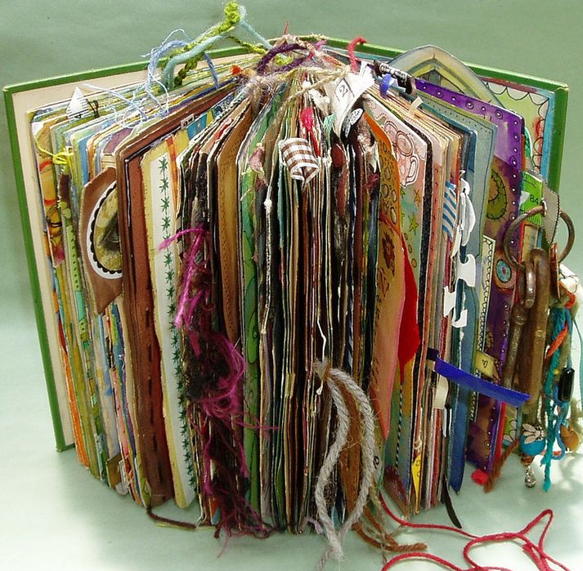
Task 6: Final response
Focus: Realisation of ideas
Task: Create a resolved piece of work IN YOUR BOOK in response to “Surfaces”.
This could be:
A painting on a double page
A series of experimental pages that are related to each other
A series of photographs with manipulated prints
A textile or paper-based surface on a double page
Be prepared to talk about your work in class. How has your idea developed? What choices did you make about surface and why?

Slide 13
Materials for sixth form
We have put together an Art Pack of basic materials that you will need for sixth form which we ask you to buy. This includes a sketchbook, folder, paints, good quality brushes etc. which we buy at cost price. Do not buy a sketchbook over summer.
Most of you will have materials already however you will definitely use everything in the pack and will find it useful to keep a separate set of some things at school.
Please ask your parents to pay the contribution for this pack on Parentpay.
It may seem like a lot of money, however A Level students use a lot of materials over the two years and the contribution we ask for covers not only the art kit but also a small amount towards other materials such as plaster, wire, mod roc, and some of the other things you use during the course.

Slide 14
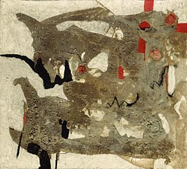
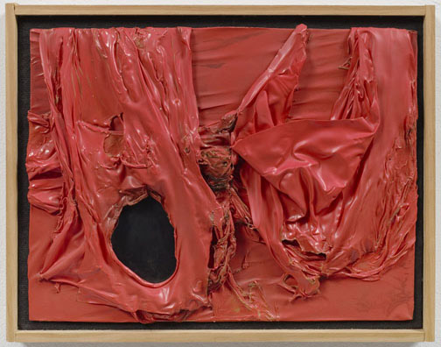
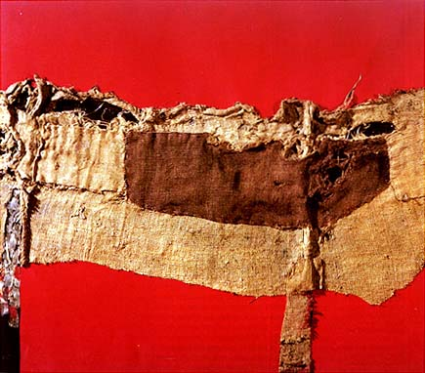
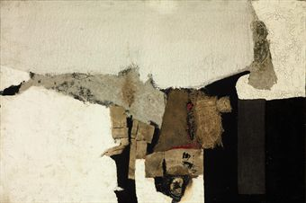
Alberto Burri
Broken Surfaces

Slide 15
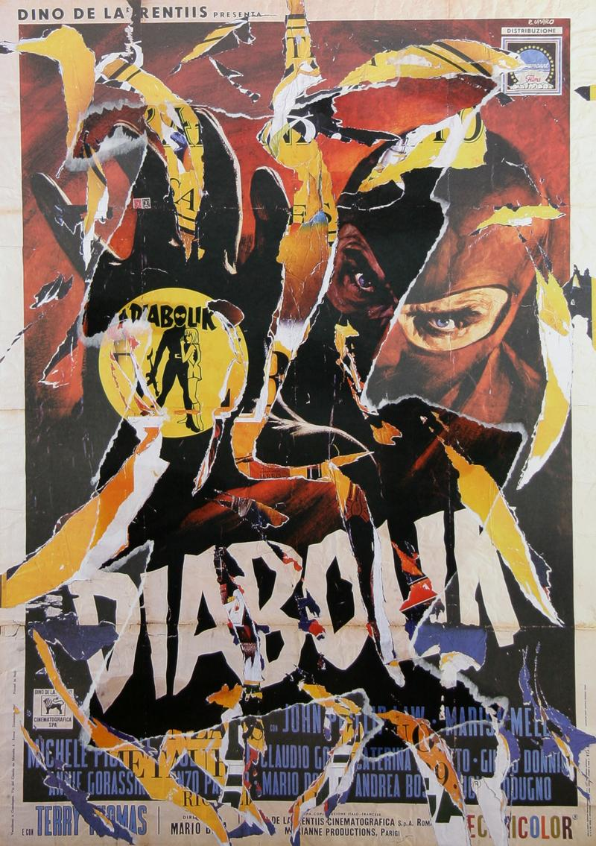
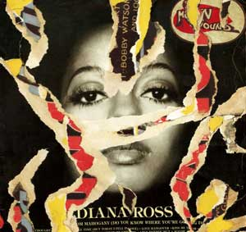
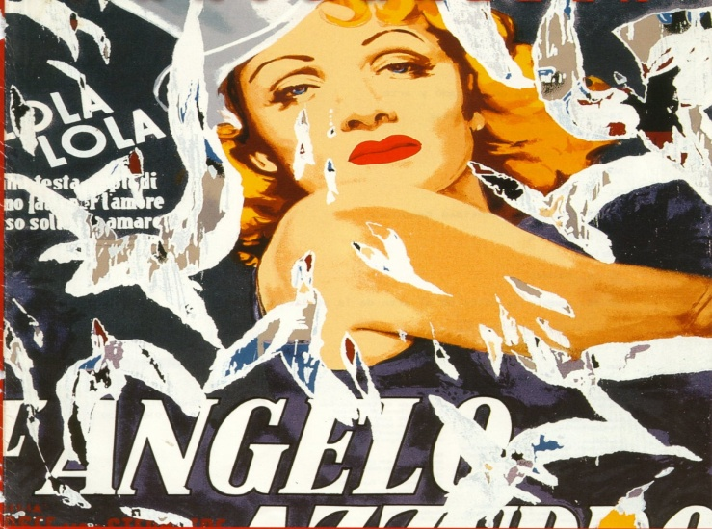
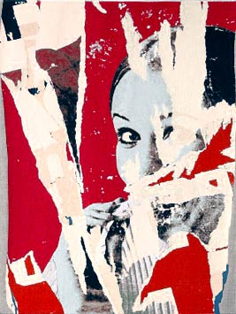
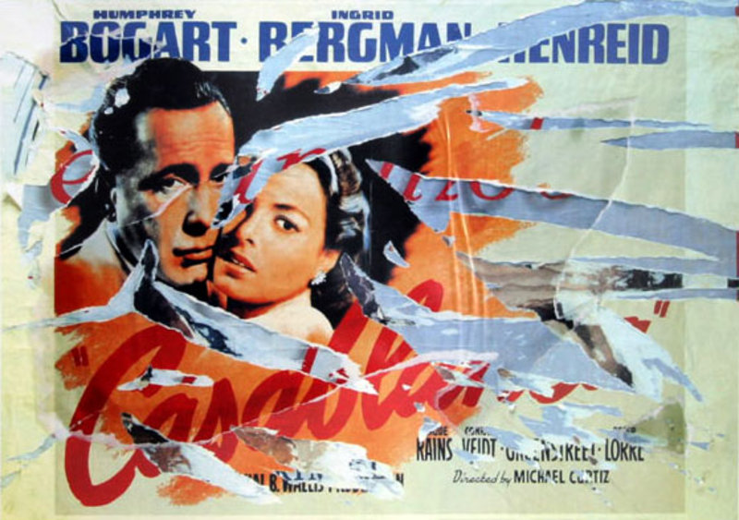
Mimmo Rotella
Broken Surfaces

Slide 16
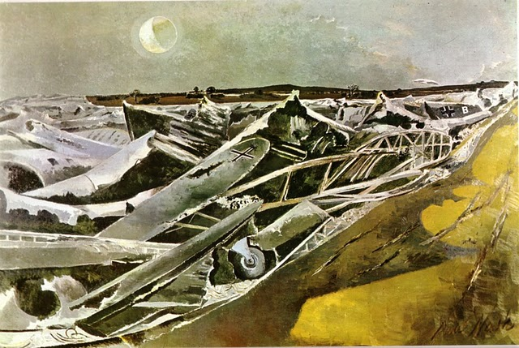
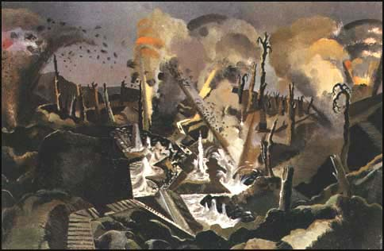
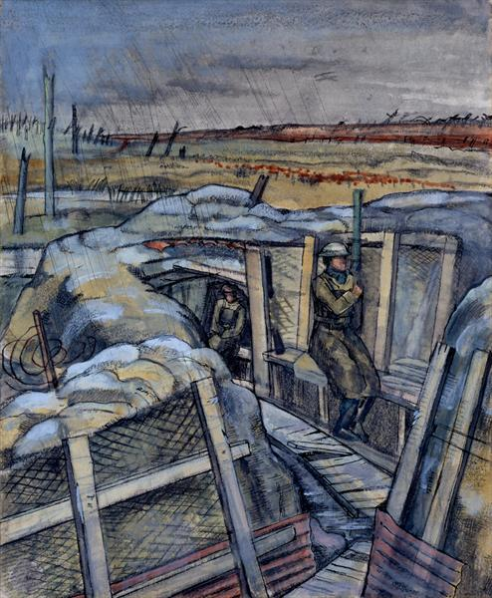
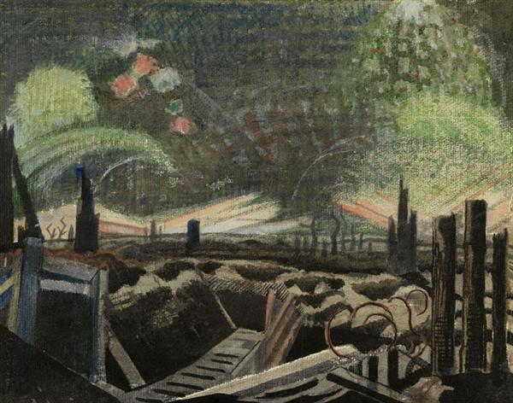
Paul Nash
Decaying Surfaces

Slide 17
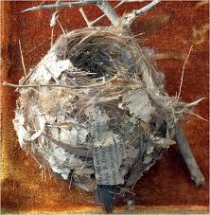
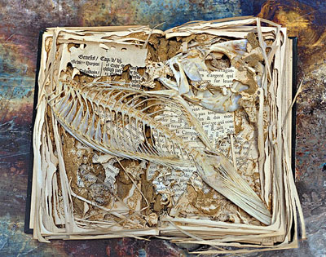
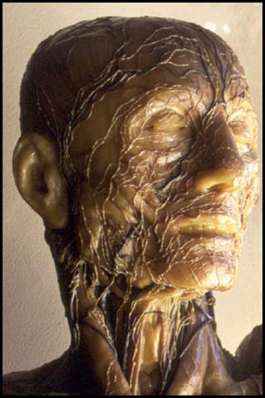
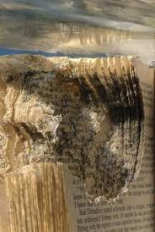
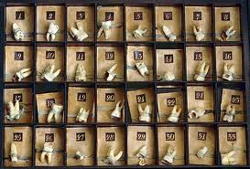
Rosamond Purcell
Decaying Surfaces

Slide 18
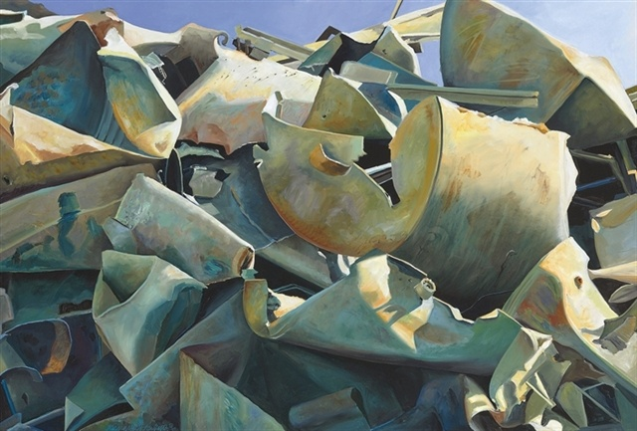
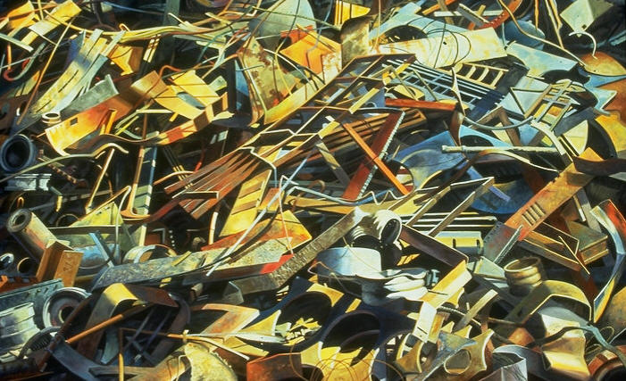
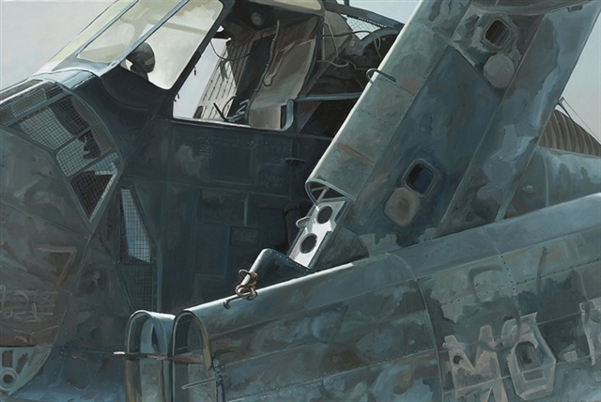
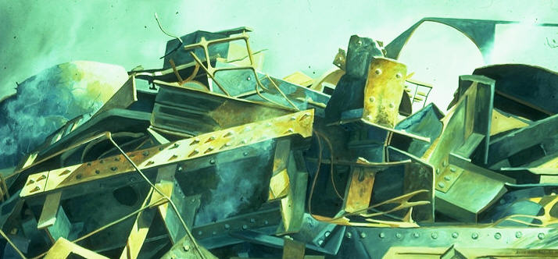
Anna Held Audette
Decaying Surfaces

Slide 19
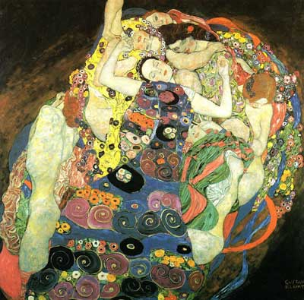
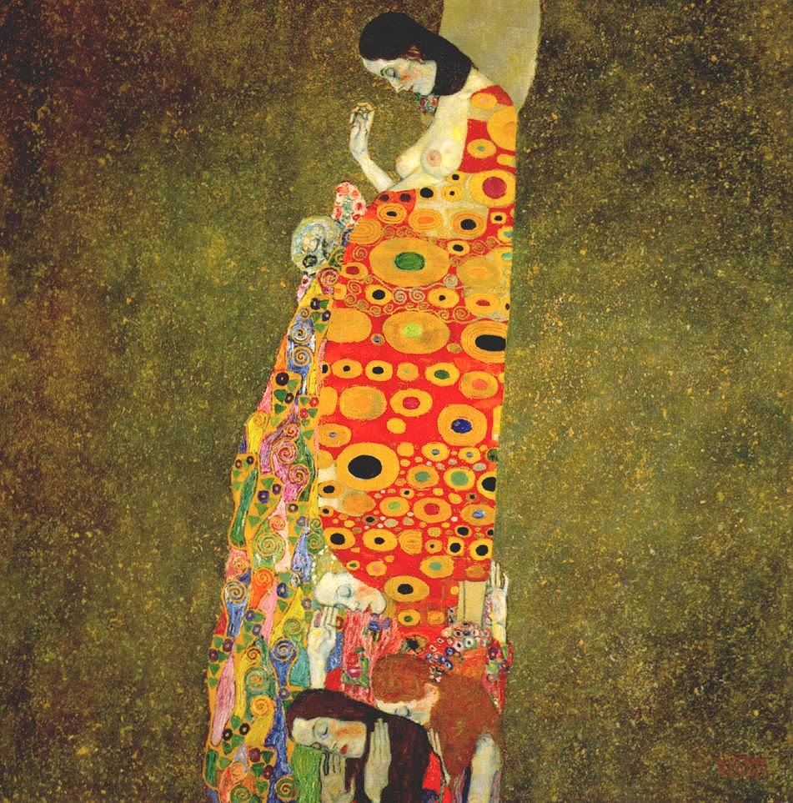
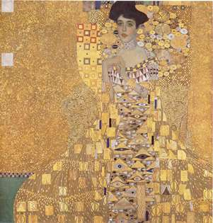
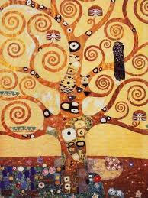
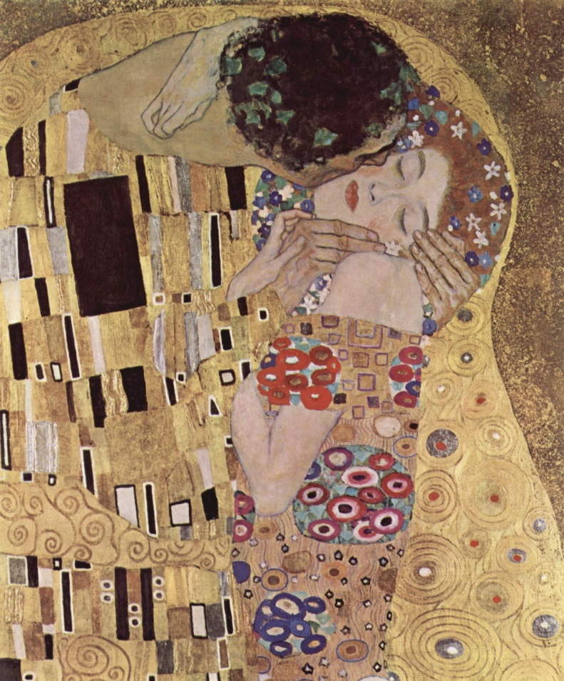
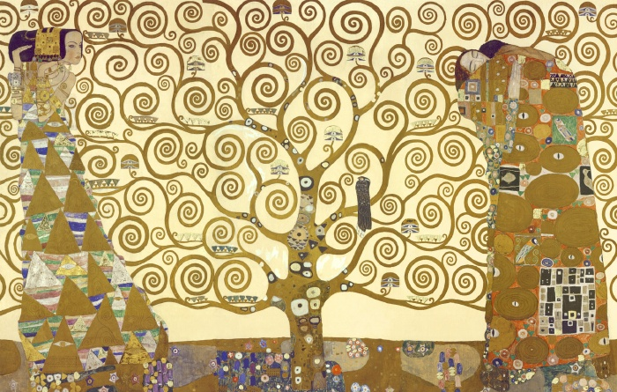
Gustav Klimt
Patterned Surfaces

Slide 20
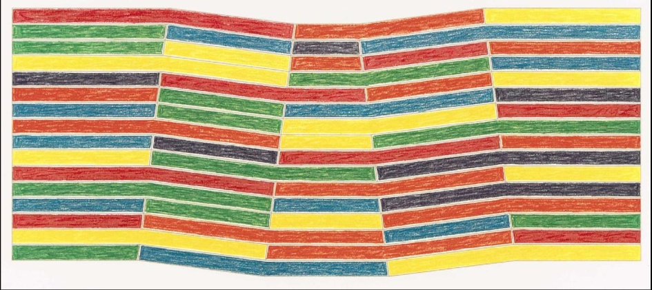
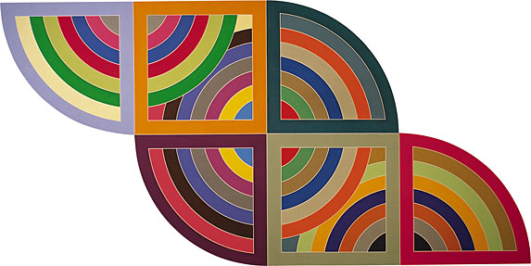
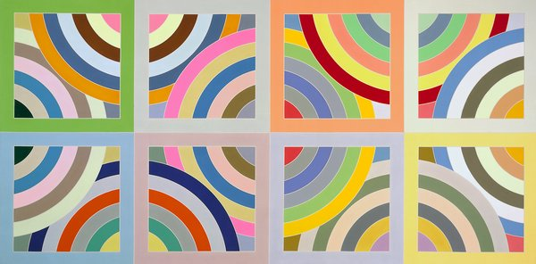
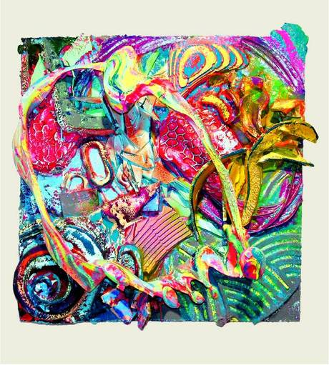
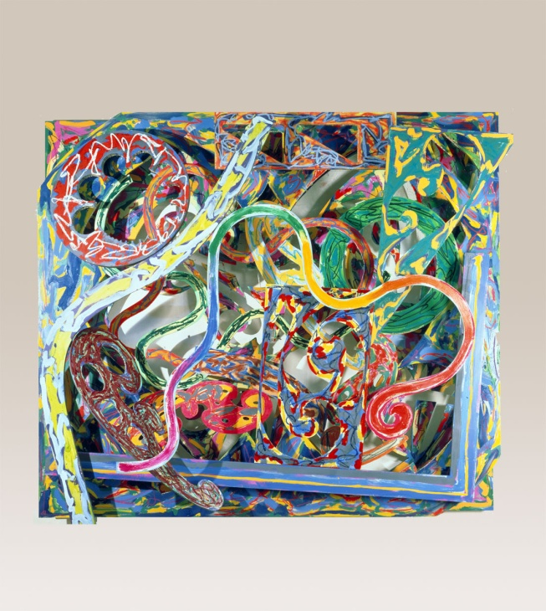
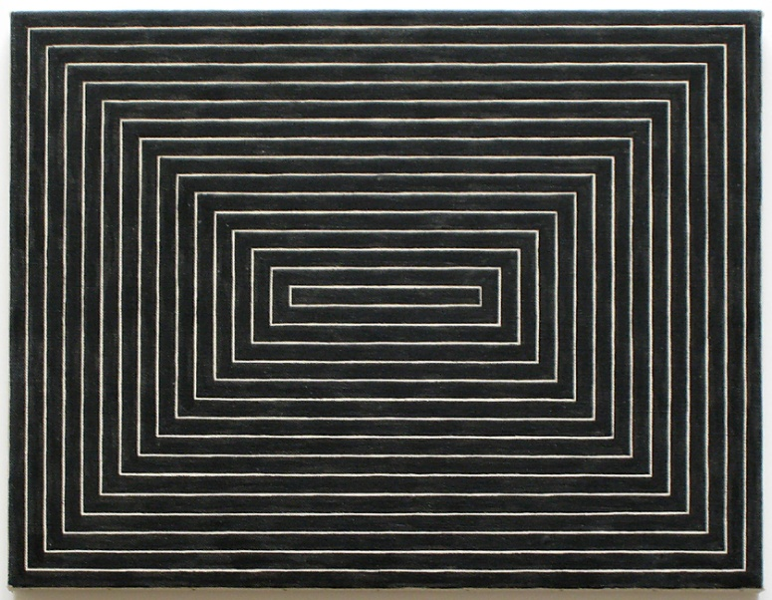
Frank Stella
Patterned Surfaces

Slide 21
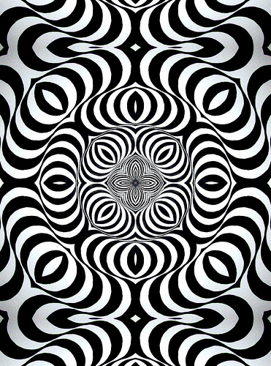
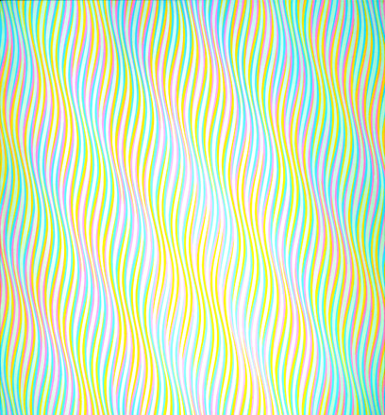
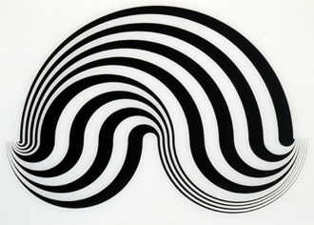
Bridget Riley
Patterned Surfaces

Slide 22
Yinka Shonibare
Patterned Surfaces

Slide 23
Henri Rousseau
Beneath The Surface

Slide 24
Zena Holloway
Beneath The Surface

Slide 25
Nick Veasey
Beneath The Surface

Slide 26
John Chamberlain
Textured Surfaces

Slide 27
Rebecca Horn
Textured Surfaces

Slide 28
Mike Kelley
Textured Surfaces

Slide 29
Seiko Kinoshita
Textured Surfaces

Slide 30
Van Gogh
Textured Surfaces

Slide 31
Tony Cragg
Contrasting Surfaces

Slide 32
Robert Rauschenberg
Contrasting Surfaces

Slide 33
Jean Tinguely
Contrasting Surfaces

Slide 34
Claude Monet
Reflective Surfaces
Kate
Brinkworth

