Slide 1
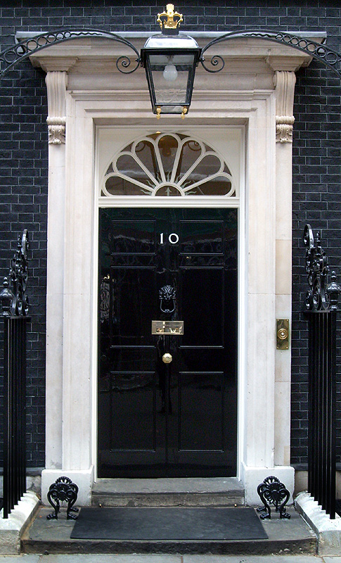
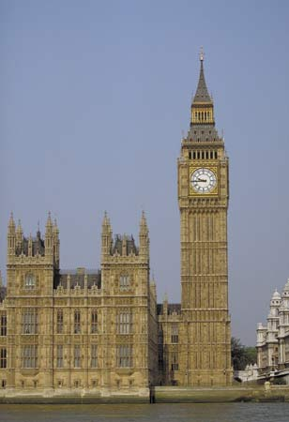
A Level Politics
Student Handbook & Induction Booklet

Slide 2
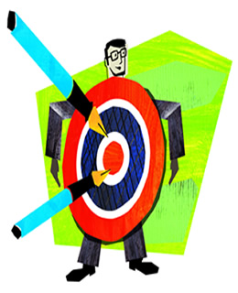
A Level Politics
WHAT DOES THE COURSE AIM TO DO?
It aims to:
Provide you with a ‘balanced education in politics’, and ‘understanding of the nature of politics, and an understanding in the context of the Untied Kingdom, including its local, national and European dimensions, and some aspects of comparative study of other political systems.’
You will be assessed on your ability to organise and present information, ideas and arguments clearly and logically in continuous prose using good quality English
THE SKILLS YOU WILL DEVELOP
· Knowledge and understanding of basic political ideas , concepts, structures and processes, the relationship between them and how they work at different levels.
· An ability to interpret and analyse political information in various forms and from various sources, and to apply a range of political ideas concepts and theories.
· An ability to evaluate arguments, theories, values and ideologies to explain political behaviour and suggest solutions to controversial issues.
· The skills to organise and present an argument with relevance, clarity and coherence using good English.

Slide 3
WHAT DOES THE COURSE INVOLVE?
What will you study?
Teacher | Topics Covered | Exam
Year 12:
Miss Taylor/Mr Brice– Year 12 | UK Politics Democracy and participation Political parties Electoral system Voting behaviour and the media | 2 hours to also include Core political ideas.
Miss Taylor – Year 12 Autumn and Spring Terms | UK Government The constitution Parliament Prime Minister and executive Relationships between the branches | 2 hours to also include Non-Core political ideas.
Mr de Jong – Year 13 | Core political ideas: Conservatism Liberalism Socialism Non-Core political ideas: Feminism | 2 exam papers 2 hours each to cover UK politics (including Core political ideas) and UK Government (including non-Core political ideas)
Year 13:
Miss Taylor | Global Politics: The State and Globalisation Global Governance: Political, Economic, Human Rights and Environmental Power and Developments Regionalism Liberalism and Realism | 1 exam paper on Global Politics 2 hours
Yr 12 Summer term and Year 13

Slide 4
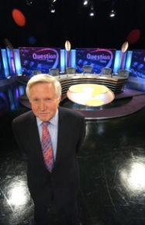
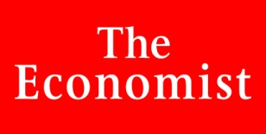
HOW WILL YOU BE SUCCESSFUL IN THIS COURSE?
YOU WILL NEED TO TAKE AN INTEREST IN CURRENT AFFAIRS AND POLITICAL ISSUES
This will involve:
Reading a QUALITY newspaper (such as The Times, Guardian, Telegraph, Independent or their Sunday equivalent;
magazines and specific politics journals such as Politics Review as well as the set textbooks.
Watching current affairs programmes such as Panorama, Despatches etc. and specific politics programmes such as ‘Sunday with Laura Kuenssberg’.
Watching the news or listening to 'Today' on Radio 4.
Discussing and debating political issues with both fellow politics students and others
Keeping a scrap book of press cuttings on politics and issues
Interest alone is not enough!
You will have to read widely and work hard to understand:
The institutions and main features of the British system of government and British politics.
How these work in theory and practice
The way they interact their strengths and weaknesses
The way they may change
Continuity is essential: Part-timers are of no use!
You will be given a variety of tasks:
Reading
Research
Short answers
Stimulus response questions
Essays.
To ensure quick feedback and a planned workload it is essential that all work is completed by set deadlines.

Slide 5
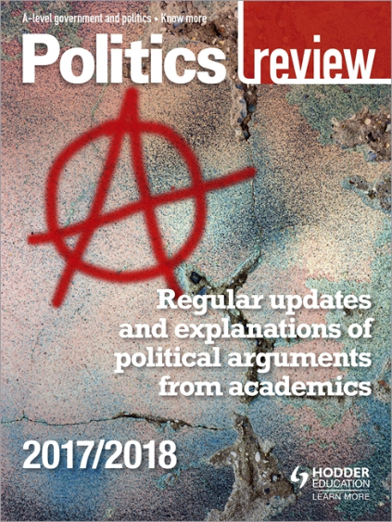
WHICH RESOURCES WILL HELP WITH MY AS STUDIES?
The textbooks will be provided by the school, the other resources here are recommended.
Documentaries
Adam Curtis, The Power of Nightmares – a comparison of neo-conservatism in the US and radical Islam.
Adam Curtis, Bitter Lake – an examination of how the west’s desire to control the Middle East has shown the seeds of radicalisation and political violence
Adam Curtis, Hypernormalisation – Why do chaotic events seem to be increasingly frequent? Curtis looks at why the War in Syria, the migrant crisis, the Trump presidency have happened and why their causes are pretty much impossible to understand.
Johan Norberg, Globalisation in Good – Norberg personal view on the impact of globalisation
Errol Morris, The Fog of War – Former Secretary of State for the Defence in the US, Robert McNamara looks back at the lessons he learnt during his career. Includes McNamara’s thoughts on the dropping of the atomic bombs on Japan at the end of the Second World War and the American campaign in Vietnam.
Errol Morris, Known Unknown – Another former Secretary of State for the Defence in the US, Donald Rumsfeld, looks back at his career. Includes his thoughts on the Iraq War. Good contrast with The Fog of War.
No Plan, No Peace: From Success to Disaster in Iraq – made by the BBC – title says it all!
Podcasts
The BBC Global News podcast
The Guardian: Today in focus
The Intelligence from the Economist
The Rest is Politics
Websites
Foreign Office Travel Wesbite, https://www.gov.uk/foreign-travel-advice - the Foreign Office’s latest take on pretty much everywhere in the world.
BISA – British International Studies Association, https://www.bisa.ac.uk/ - designed especially for students. There is a newsletter you can sign up to.
Subscription to the Politics Review.
https://www.hoddereducation.co.uk/Product/9781471890598.aspx

Slide 6
Keep up to date with the news:
The Week (http://subscription.theweek.co.uk/subscribe/)
The Economist (https://subscriptions.economist.com)
The Guardian http://www.guardian.co.uk/
The Telegraph http://www.telegraph.co.uk/
The Independent http://www.independent.co.uk/
The Times http://www.thetimes.co.uk/
BBC News http://www.bbc.co.uk/news/
PoliticsHome http://www.politicshome.com/uk/
Labour List http://labourlist.org
Conservative Home http://www.conservativehome.com
UK Government and Politics Books
The UK constitution Anthony King Who Governs Britain? Martin Loughlin
The British Constitution: A Very Short Introduction British Politics & History: Andrew Marr
A History of Modern Britain Andrew Rawnsley
The End of the Party Ben Pimlott Harold Wilson
Boris Johnson’s The Churchill Factor: How One Man Made History
Charles Moore Margaret Thatcher: The Authorised Biography (Vol. 1)
Dominic Sandbrook Never Had It So Good: A History of Britain from Suez to the Beatles
Seasons in the Sun: The Battle for Britain, 1974-1979,
State of Emergency: The Way We Were: Britain, 1970-1974
White Heat: A History of Britain in the Swinging Sixties 1964-1970
John Campbell The Iron Lady John Murray and Anthony Sampson Who Runs This Place?: The Anatomy of Britain in the 21st Century
Jeremy Paxman published a book on the First World War and he also made a documentary based on it, Great Britain's Great War
Jonathan Powell's memoir about the Blair government is very entertaining, The New Machiavelli

Slide 7
Global Politics Books
John Andrews, The World in Conflict – a consideration of the big questions about war and violence. Why does it happen? What forms does it take? Where and how might future conflict happen?
Ha Joon Chang, 25 Things They Don’t Tell You About Capitalism – Has the washing machine changed the world more than the internet? Does the USA have the highest standard of living in the world? Are people in poor countries more entrepreneurial than those in rich ones? Chang answers these questions and many others in a way that engages and entertains.
Ha Joon Chang, Kicking Away the Ladder – Chang makes the provocative argument that developed countries are attempting to ‘kick away the ladder’ with which they climbed to the top, thereby preventing developing countries from adopting the policies that they themselves used.
Amy Chua, World on Fire - a World Bank economist argues that the global spread of free market economics creates tension and resentment which have led to a more dangerous and divided world
Thomas Friedman, The World is Flat – A powerful defence of the free market as the route to global prosperity and peace. A good contrast with Amy Chua’s World on Fire
Richard Haas, A World in Disarray – an interesting insight into contemporary politics by the president of UN’s Council on Foreign Relations: ‘These are no ordinary times. It will not be business as usual in a world of disarray; as a result, it cannot be foreign policy as usual.’
Henry Kissinger, World Order – the master of realpolitik defends a realist approach to managing world events
Tim Marshall, Prisoners of Geography – an examination of how far a nation state’s foreign policy is determined by its geographical location. Through a series of case studies of individual countries, Marshall considers the extent to which world leaders are prisoners of their own geography or whether they are free to determine their own foreign policy.
Douglas Murray, The Strange Death of Europe: Immigration, Identity and Islam – Murray views Europe as a continent bent on destroying its traditional culture through declining birth rates, acceptance of mass immigration and cultivated disgust and self hatred. Controversial.
Tim Shipman, All Out War: The Full Story of how Brexit Sank Britain’s Political Class – a well written account of how and why Britain voted to leave the EU.
Joseph Stiglitz, Globalisation and its Discontents – the former World Bank vice president condemns the neo-liberal Washington consensus with the zeal of a convert
Guy Verhofstadt, Europe’s Last Chance – an endorsement of closer European integration

Slide 8
Induction Tasks
TASK 1: complete the following activities. You will need to start with the booklet ‘Parliament Find Your Way’. Read the relevant pages in this booklet and then complete the following tasks.
1. The History of Parliament
Read page 4-5 in the booklet.
Visit www.parliament.uk/housesofhistory
Create a timeline to illustrate the ‘Journey to Democracy’.
2. Democracy
Read page 6-7 in the booklet.
Write a definition for the following words:
Democracy
Representative democracy
Direct Democracy
Politics
Dictatorship
Suffrage
Franchise
Watch ‘Democracy? You Decide’: http://www.parliament.uk/education/teaching-resources-lesson-plans/democracy-parliament-and-government-video/you-decide-video/
Answer the following question:
What would the UK be like if we didn’t live in a democracy?
What are the strengths and weaknesses of the UK system of democracy?
What other options are there and where are they in place right now?
3. The Constitution
Read page 8-9 in the booklet.
Write a definition of the following words:
Constitution
Uncodified constitution
Codified constitution
Parliamentary sovereignty
Devolution
The Human Rights Act
The European Union
The UK Supreme Court

Slide 9
4. The constitution: The EU
Read page 10-11 in the booklet.
Visit http://Europa.eu
Use your research to answer the following question:
In what areas can the EU make laws that the UK has to follow?
What happened if there is conflict between EU law and UK law?
Provide an example of where EU and UK law has conflicted – what was the outcome?
Make a list of the pros and cons of the UK being a member of the EU.
Study the results of the EU referendum on the 23rd June – what was the outcome? Why do you think this side won?
5. Parliament
Read page 12-17 in the booklet.
Write a definition of the following words:
Bicameral legislature
House of Commons
House of Lords
Monarch
Legislation
Scrutiny
Representation
Two-House system
Bills
The Queen’s Speech
Select Committees
General Committees
Public Bills Committee
Grand Committees
Liaison Committee
Prime Minister's Questions
Ministerial Questions
What role does the monarch have in our Parliament?
What is the benefit of a two-House system?
What is the key role of the committees?
What is the main different between the House of Commons and the House of Lords?
Who do MPs represent?
Constituents
MPs
Government Minister
Backbencher
The Executive
Government
Opposition
Cabinet
Speaker
The Legislature
Crossbenchers
Lord Speaker
House of Lords Act 1999
Hereditary Peers
Life Peers
Peers Spiritual

Slide 10
5. Parliament cont’d
What is the difference between the Executive and the Legislature?
How in the UK system of government do these over-lap? (Clue: this is called Fusion of Power)
What is the major problem with the House of Lords in terms of democracy?
What are the pros and cons of having an unelected second chamber?
Who would you nominate as a Life Peer and why?
High Court Judges also used to sit in the House of Lords: where do they now sit? Why do you think it was important to separate them from the work of the House of Lords?
6. Legislation: Making New Laws
Read page 12-17 in the booklet.
Write a definition of the following words:
Public Bills
Government Bills
Private Members Bills
Manifesto
Amendments
Division
Filibuster
Free Vote
Green Paper
Motion
Ping-Pong
Tellers
Wash-up
White Paper
Play the following game: www.parliament.uk/myuk
Answer the following questions:
What one law would you make and why?
How would you enforce the law?
What implications might it have for communities in the UK?

Slide 11
7. Elections and Voting
Read page 20-21 in the booklet.
Write a definition for the following words:
General election
Devolved Assembly/ Parliament elections
European elections
Local elections
By-elections
Referendums
Read through the different types of voting systems on page 21. Which do you think would be the best system for the UK to adopt for General Elections and why?
In 2011 there was a referendum on introducing AV. Research the outcome of this referendum. Why do you think this outcome occurred?
8. Elections and Voting: Trends and Types
Read page 22-23 in the booklet.
Write a definition for the following words:
Voter Turnout
Polling Day
Compulsory Voting
Separation of Powers
Proportional Representation
Why do you think voter turnout is low in Britain?
Should the UK make voting compulsory? What are the arguments for and against?
Should the voting age be lowered to 16? What are the arguments for and against?
You will soon be old enough to vote – how do you register to vote?
Go to www.parliament.uk/referendums and research another referendum that has happened in the UK. (Do not select the AV Vote or the EU referendum)
What was the topic of the referendum? What was the turnout? What was the
outcome?

Slide 12
9. Political Parties
Read page 24-25 in the booklet.
Write a definition for the following words/topics:
Political Party
Coalition government
Majority
Functions of political parties
Party Whips
Party Rebels
‘withdrawing the whip’
Which political party currently governs this country?
How many seats (or MPs) do the three main parties each have in the House of Commons?
Research the main political position of the three main political parties in the following areas:
Immigration
Taxes and the Economy
The NHS
Security, defence and foreign affairs
Jobs
Education
Law and Order
Benefits/ Poverty
Who would you vote for and why>
10. Pressure Groups
Read page 26-27 in the booklet.
Write a definition for the following words/topics:
Pressure Group
Lobbying
Petitions
Popular protest
Celebrity endorsement
Direct Action.
How is a pressure group different from a political party?
Research one pressure group – why is its aim? Who does it represent? What methods has it used to try to get its message across? How successful has it been?

Slide 13
Current Affairs Diary
TASK 2: in addition to these research projects you must also start your current affairs diary in the summer holidays. You will continue to keep this diary throughout your time studying politics in the sixth form.
How to keep a current affairs diary:
Each week listen to, watch or read the news and make a list of the top three news stories. You can do this by looking at one of the internet news sites and/or spending some time each day in the school library or at home looking at a newspaper.
In your diary make a list of the top three stories, including a brief outline of what has happened.
By the end of the summer, select one of these stories and write a short editorial on it. This should include:
An objective explanation of the issue. How it has progressed.
Opinions from different viewpoints.
Your opinion – including where applicable alternative solutions to the problem or issue being criticised.
Do not just copy and paste from the internet, particularly with word definitions – make sure that you really understand everything you write. This may mean that you need to do further research to develop your understanding.

